Slide 1
Airbnb Price Model
DATS_6501_10 Capstone
Selina Chang

Slide 2
OUTLINE
Problem Statement
Literature Reviews
Process Flow
Airbnb Datasets of New York
Add More Features Based on GIS
Feature Selection
Forecasting Models
Linear Regression
SVR
XGBoost
Conclusion

Slide 3
PROBLEM STATEMENT
Is it worthy of being a Airbnb host ?
Approach Airbnb house price model using open data and machine learning techniques.
hosts
tourists
Airbnb listing price

Slide 4
LITERATURE REVIEWS
A company charges hosts to get recommended price.
In 2018, employers from Airbnb in KDD proposed a customized regression model based on current Airbnb dynamic pricing (Ye et al).
In 2019, a paper included NLP to approach Airbnb price model (Kalehbasti,Nikolenko& Rezaei, 2019).

Slide 5
PROCESS FLOW
Exploratory Data Analysis
Split Data
Feature Selection
Evaluation Models
remove outliner
training : testing =7:3
Scaler Variables
StandardScaler
Lasso
Based on adjusted r2
add more features
Forecasting Models
Hyperparameters Tuning
Notes:
https://www.kaggle.com/jrw2200/xgboost-hyperparameter-tuning
https://www.analyticsvidhya.com/blog/2016/03/complete-guide-parameter-tuning-xgboost-with-codes-python/
https://www.itread01.com/content/1545830225.html
https://towardsdatascience.com/boosting-algorithm-xgboost-4d9ec0207d

Slide 6
DATASETS
New York City Airbnb Open Data is from Kaggle
The dataset contains 48,895 records under 15 variables
 | Variable Name | # of unique values | # of missing data
1 | listing ID | 48895 | 0 | listing identity
2 | name of the listing | 47905 | 16 | listing identity
3 | host ID | 37457 | 0 | listing identity
4 | name of the host | 11452 | 21 | listing identity
5 | boroughs | 5 | 0 | location
6 | neighborhoods | 221 | 0 | location
7 | latitude | 19048 | 0 | GIS information
8 | longitude | 14718 | 0 | GIS information
9 | listing space type | 3 | 0 | room type
10 | price | 674 | 0
11 | amount of nights minimum | 109 | 0 | host status
12 | number of reviews | 394 | 0 | host status
13 | latest review date | 1764 | 10052 | host status
14 | number of reviews per month | 937 | 10052 | host status
15 | amount of listing per host | 47 | 0 | host status

Slide 7
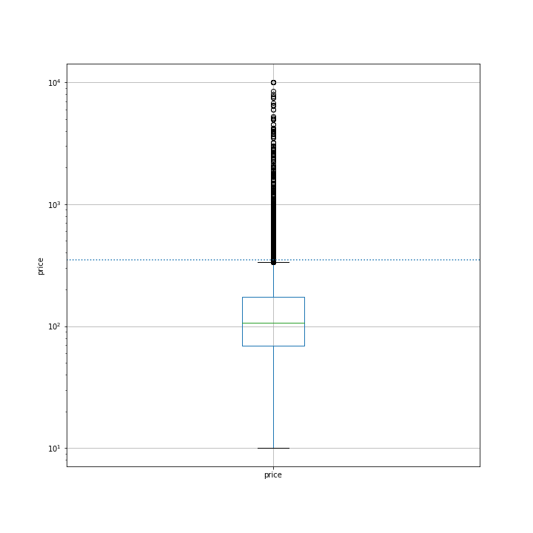
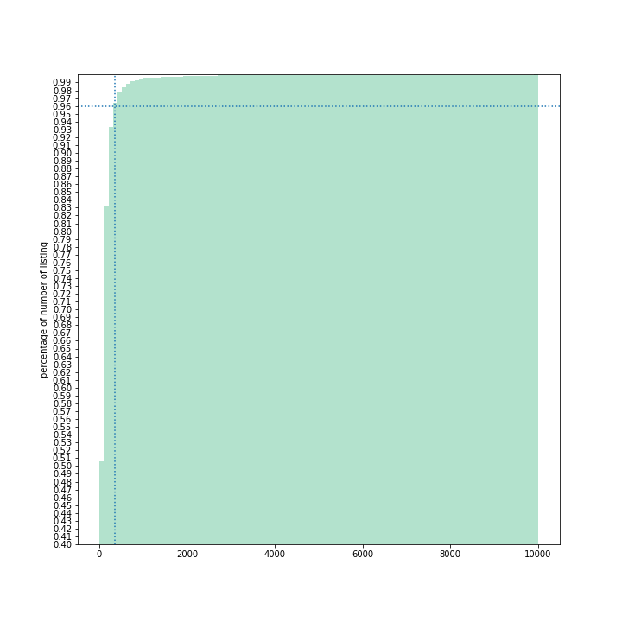
PRICE
Working with outliers: removing
Using the interquartile range (IQR) score to identify outliners
Remove outliners occupying less 4 percent of the dataset
cumulative histogram plot of price
0.96
350
350
Price

Slide 8
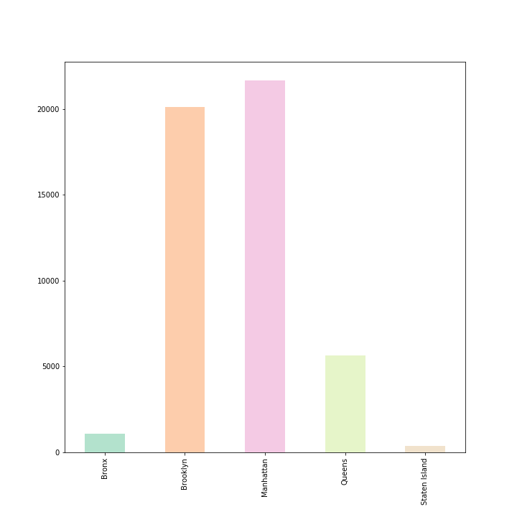
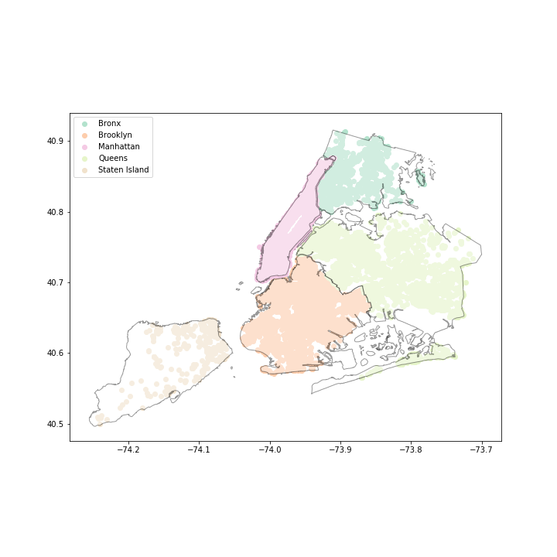
BOROUGH
There are five boroughs in New York

Slide 9
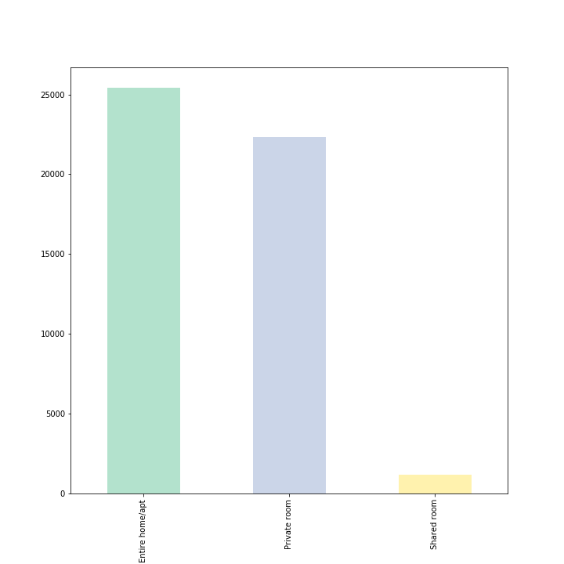
SPACE TYPE
The variable of space type is considered as the categorical variable
Three types of space types : Entire Apartment, Private Room, and Shared Room
Encode this category with a one hot encoding (OHE) vector (or dummy variables)

Slide 10
ADD MORE FEATURES
Using GeoPandas and open datasets based on the latitude and the longitude to add more features related to the location
Distance to the nearest metro
NYC OpenData provides the datasets of locations of subways in the format of geojason. The distance to the nearest metro is calculated.
The number of museums within 500m
Distance to the nearest top-10 popular scene
Top-10 popular sciences are Statue of Liberty, Rockefeller Center, Metropolitan Museum of Art, and the others.
Using the package of geopy to get the GIS information for the top-10 scenes
The number of top-10 scenes within 500m

Slide 11
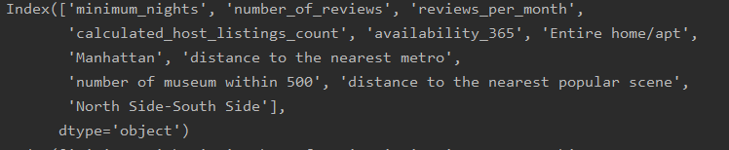
FEATURE SELECTION
Least absolute shrinkage and selection operator (LASSO), one of embedded methods used for feature selection, is adopted to select useful features.
Normally has a better result than stepwise regression
Select 11 variables from 221 variables(211 variables are from neighborhoods)
Variables with a non-zero coefficient:

Slide 12
FORECASTING MODELS
Linear Regression
Baseline
SVM Family
Sophisticated regression line: using RBF Kernel
Explainable
High Accuracy and Fast
SVR
XGBoost
Ensemble Model
Adjust R-squared =45.84

Slide 13
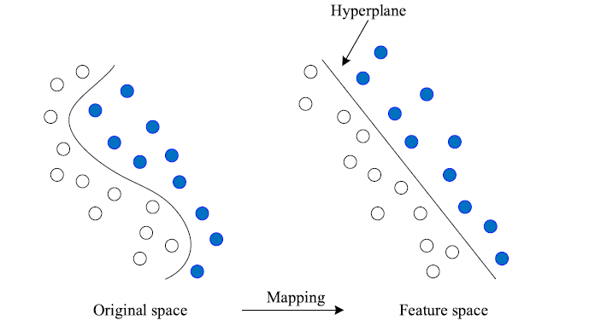
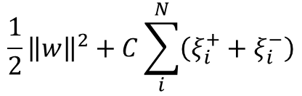

SVR
The objective function of support vector regressor (SVR) :
Nonlinear support vector regressor uses RBF kernel function to build a nonlinear hyperplane.
Hyperparameter C and gamma are selected to do hyperparameter tuning by cross-validation
$$\frac{1}{2}{\left\|w\right\|}^{2}+C\sum_{i}^{N}{\left(ξ_{i}^{+}+ξ_{i}^{−}\right)}$$
K$\left(X_{i},X_{j}\right)=e^{\left(−γ{\left\|X_{i}−X_{j}\right\|}^{2}\right)}$

Slide 14
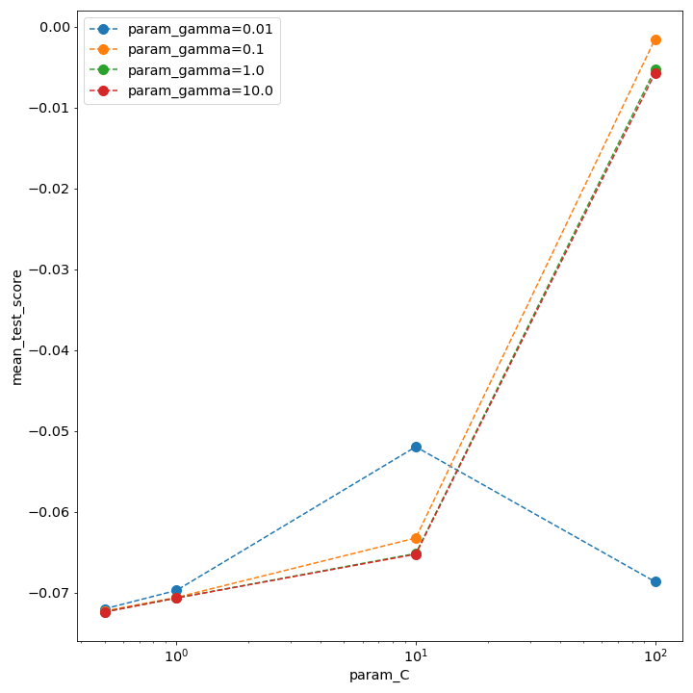
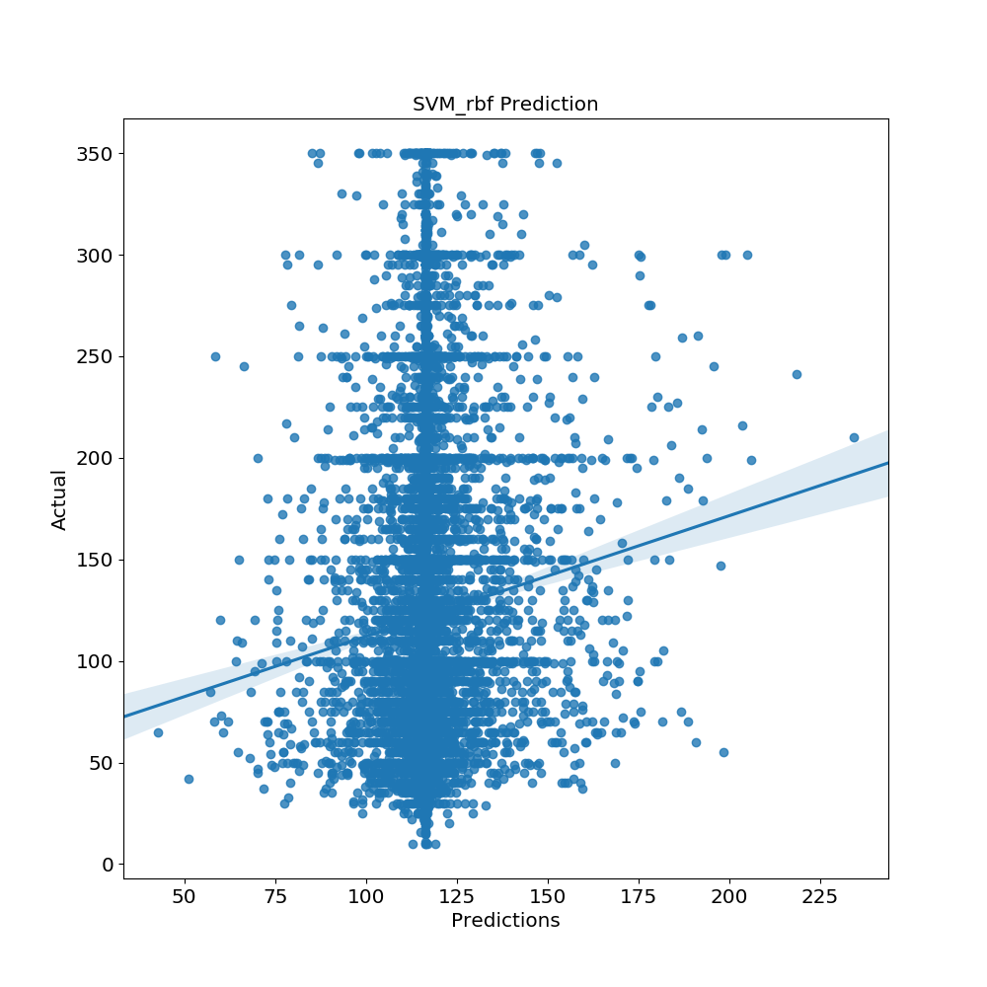
SVR
Hypermeter Tuning
C=100 and γ=0.1
Adjust R-squared=-0.28

Slide 15
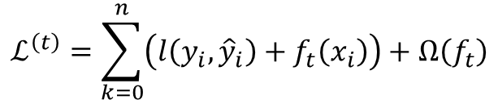
XGBoost
XGBoost is an implementation of gradient boosted decision trees.
The objective function of XGBoost:
Tree booster is adopted in this project.
5 Hyperparameters are selected to do hyperparameter tuning by cross-validation :
Number of trees
Boosting learning rate
Maximum tree depth for base learners
L2 regularization term on weights
Minimum loss reduction required to make a further partition on a leaf node of the tree
$$ℒ^{\left(t\right)}=\sum_{k=0}^{n}{\left(l\left(y_{i},{\hat{y}}_{i}\right)+f_{t}\left(x_{i}\right)\right)+Ω\left(f_{t}\right)}$$

Slide 16
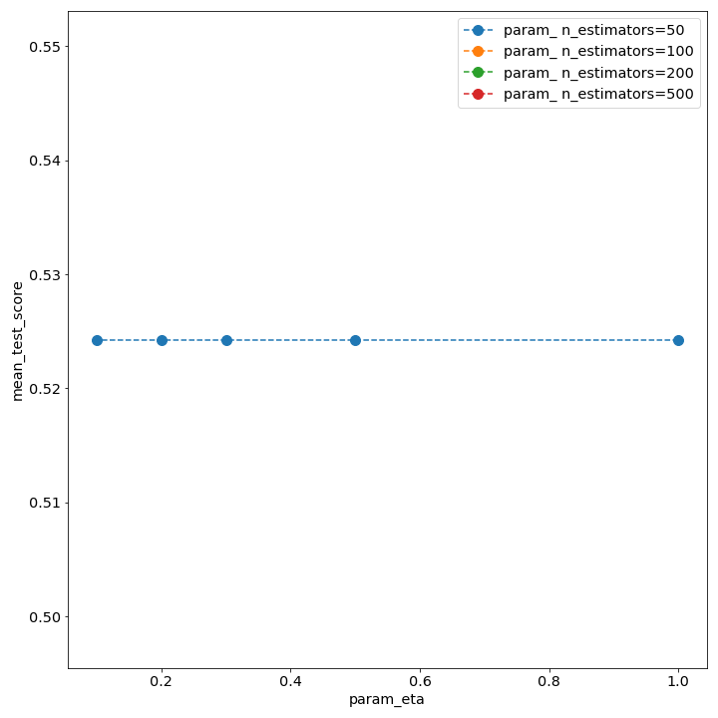
XGBoost
5 Hyperparameters are selected to do hyperparameter tuning by cross-validation :
Number of trees
Boosting learning rate
Maximum tree depth for base learners
L2 regularization term on weights
Minimum loss reduction required to make a further partition on a leaf node of the tree

Slide 17
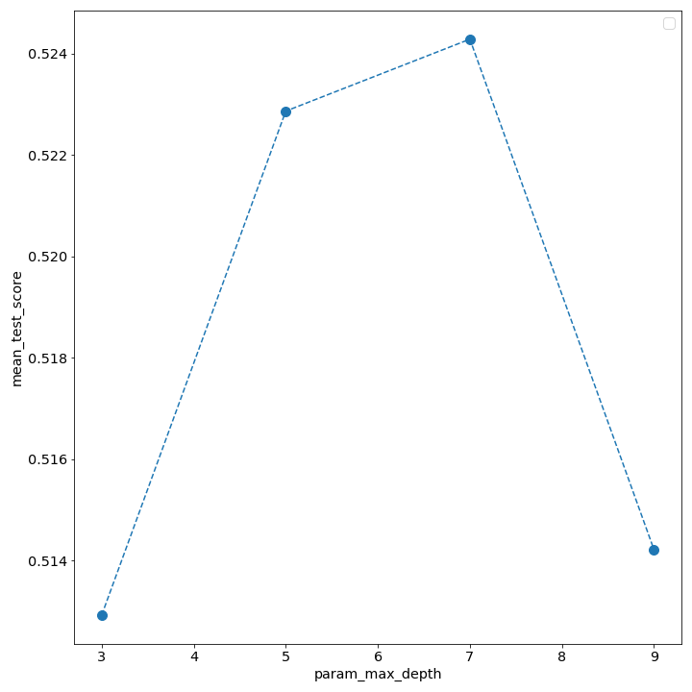
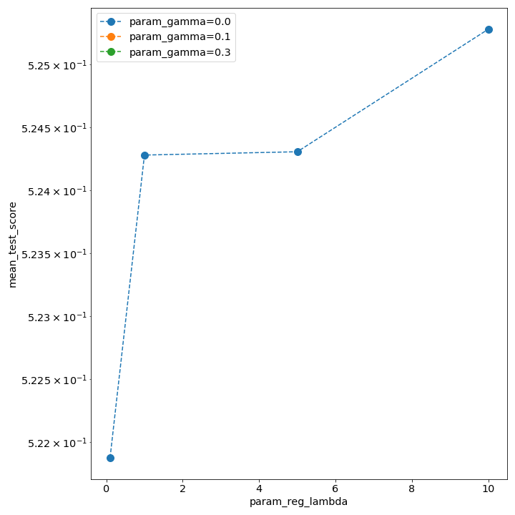
XGBoost
5 Hyperparameters are selected to do hyperparameter tuning by cross-validation :
Number of trees
Boosting learning rate
Maximum tree depth for base learners
L2 regularization term on weights
Minimum loss reduction required to make a further partition on a leaf node of the tree

Slide 18
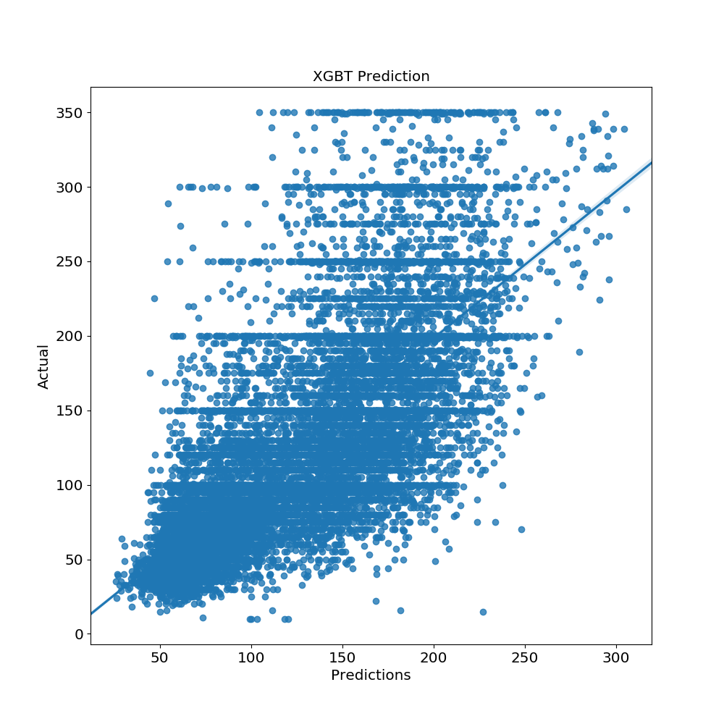
XGBoost
In practical, XGBoost has better performance at accuracy.
Adjust R-squared=53.17

Slide 19
FORECASTING MODELS
Linear Regression
Baseline
SVM Family
Sophisticated regression line: using RBF Kernel
Explainable
High Accuracy and Fast
SVR
XGBoost
Ensemble Model
Adjust R-squared =45.84
Adjust R-squared=-0.28
Adjust R-squared=53.17

Slide 20
COCLUSION
More features based on GIS information is included in this project.
Feature selection using Lasso is implemented in this project.
XGBoost has better performance as regressor in my model.

Slide 21
QUESTIONS

Slide 22
THANK YOU

Slide 23
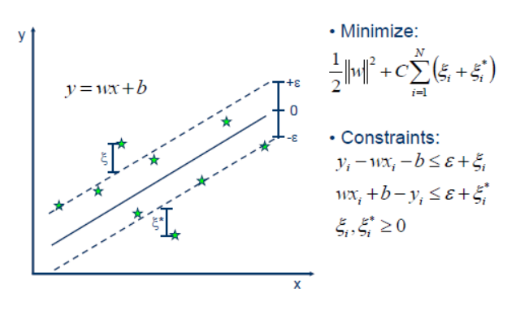
FORECASTING MODELS SVR

Slide 24
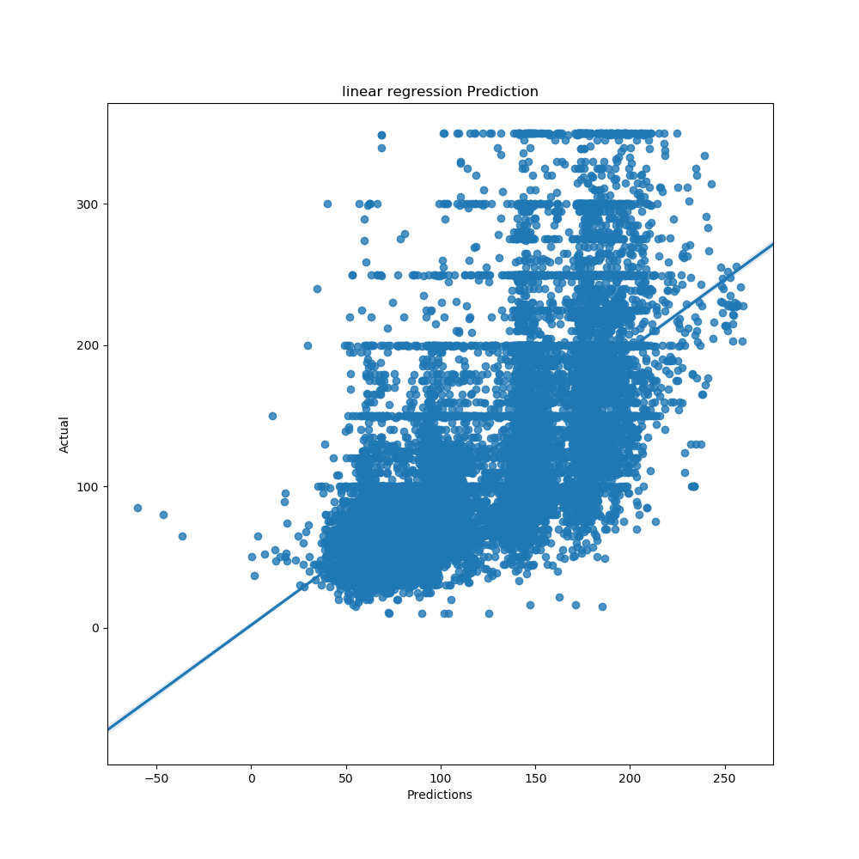
FORECASTING MODELS -LR
Linear regression
Adjust R-squared =45.84

